Slide 1
NMDOT District 4
Permitting Program
NERTPO Meeting
Santa Rosa, NM
February 28, 2018

Slide 2
NMDOT Permits
Utility Permit
Temporary Work Permit
Driveway Permit
Special Event Permit
Landscape Agreement
Interstate Access Permit
Fencing Agreement
Fencing Cooperative Agreement

Slide 3
Utility Permit
Required for any publicly, privately, cooperatively, municipally or governmentally owned facility used for carriage, distribution or transmission of water, gas, electricity, oil and products derived therefrom, sewage, stream, or other product carried by means of pipelines, conduits, wires, culverts, ditches, conveyors or other methods.
Review Period – normally up to 40 work days from submittal of “complete” permit application.
Incorrect or incomplete permit applications will be returned for correction/completion.

Slide 4
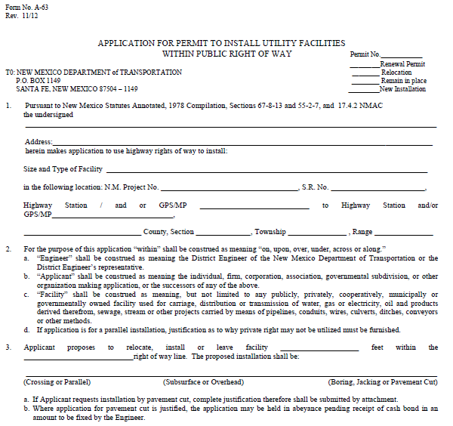
FORM NO. A-63

Slide 5
Utility Permit
Requirements for application:
  Four completed Utility Permit Applications
    Must be signed by Owner or Official Designee
  Vicinity Map of Work Area
  Four 11”x17” copies of utility
  Environmental/Cultural Resources Clearances
Clearance Received from NMDOT Environmental Section
  Copy of Certificate of Insurance
  Must be in the amount of $1,000,000 per occurrence during the project-with the NMDOT named as also insured

Slide 6
Utility Permit
Requirements for application (continued):
  Traffic Control Plan
  Proof of compliances with National Pollutant Discharge Elimination System (NPDES).
  If disturbance is more than 1 acre
  Other approvals/authorizations/permits must be obtained and copies attached, from Indian, Federal and other State agencies where required.
  Proof of compliance with SWPPP
  SWPPP Plan Must be approved BY NMDOT Drainage Section

Slide 7
Temporary Work Permit
Used for permitting any work impacting an NMDOT facility, such as utility repair work, signal & lighting work, etc.
Application Requirements:
  Completed Application
  Traffic Control Plan
  Copy of Certificate of Insurance
  Must be in the amount of $1,000,000 per occurrence during the project-with the NMDOT named as also insured
  Hold Harmless/Indemnification Agreement
  Must be notarized

Slide 8
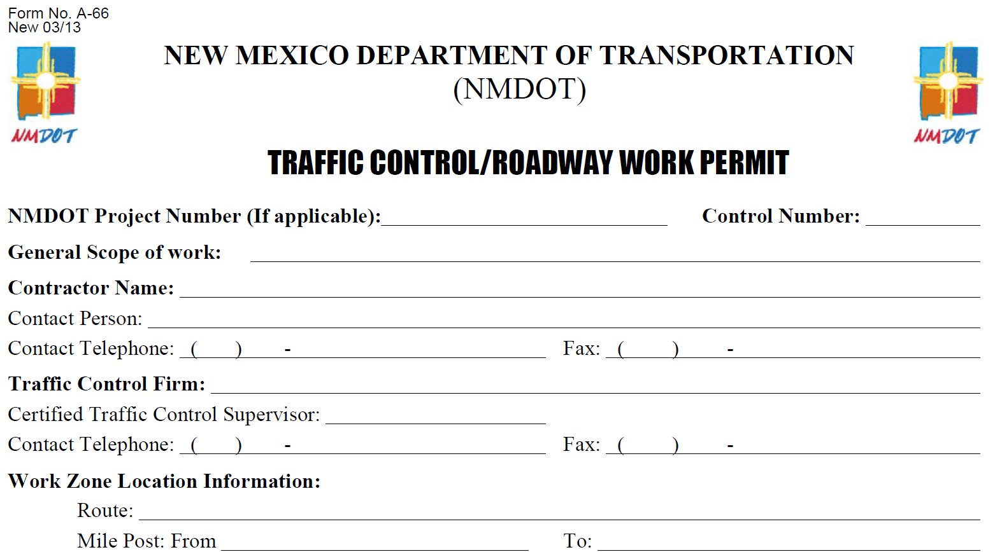
FORM NO. A-66

Slide 9
Driveway Permit
Covered by 18.31.6 NMAC & NMDOT State Access Management Manual
Required for:
  All New Accesses, permanent or temporary
  Modification or transfer of existing lawful access permit
  Upgrading and existing illegal access to a lawful access
  Changes in property use

Slide 10
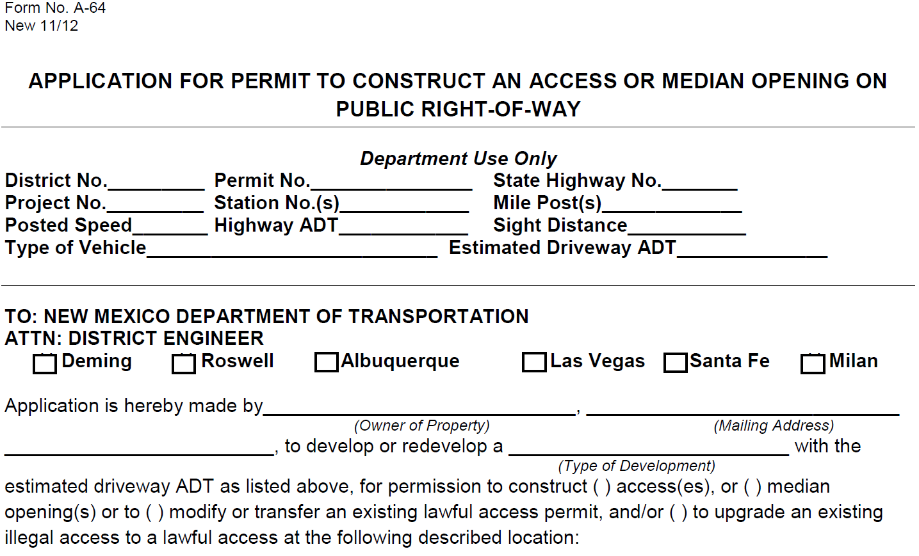
FORM NO. A-64

Slide 11
Driveway Permit
Residential Driveway Permit Requirements:
  Proof of Ownership (A copy of one of the following documents)
    Warranty Deed
    Survey Plat
    Copy of Current Property Owners “Tax Bill”
  Notarized
    Permits must be signed by the owner and notarized.
  Contact Phone Numbers
  Home Phone
Cell Phone
  Location of Proposed Driveway(s)
Route # and Milepost to the nearest 1/10 of a mile
Mark proposed driveway location with some type of marker such as ribbon, flag, etc. (Identify Type of Marker on Application)

Slide 12
Driveway Permit
Commercial Driveway Permit Requirements:
  Same requirements as residential driveway plus the following:
  Site layout on an 11’ x17” sheet
  Traffic Analysis (Level required depends on traffic generated)
  Site Threshold Assessment (STH) - Less than 25 Peak Hour Trips
  Site Traffic Analysis (STA) – 25 to 100 Peak Hour Trips
  Traffic Impact Analysis (TIA) – More than 100 Peak Hour Trips
  Design Plans for any roadway geometric improvements
Plans to include detailed dimensional layouts of all improvements
  Traffic Control Plan
  Site Grading and Drainage Plan
  Must be approved BY NMDOT Drainage Section

Slide 13
Driveway Permit
Commercial Driveway Permit Requirements:
  SWPPP Plan
  Must be approved BY NMDOT Drainage Section
  Environmental/Cultural Resources Clearance
Clearance Received from NMDOT Environmental Section
Driveway must be constructed within 6 months of date of issuance of the permit or permit will expire.
If unable to construct within 6 months, an extension can be requested, in writing. Must include explanation of why it was unable to be constructed within the required 6 months.
It is the applicants responsibility to construct and maintain the access.
Permit review period is normally up to 45 work days from submittal of “complete” permit application.

Slide 14
Special Event Permit
Permit Application Requirements
  Cover Letter explaining event and need to use NMDOT Right of Way
  List of local government approvals
  Traffic Control Plan
    If utilizing law enforcement, must have written acknowledgement/ concurrence from the law enforcement agency
  Clear map of proposed route
  Certificate of insurance
  Must be in the amount of $1,000,000 per occurrence
  NMDOT must be listed as additionally insured
  Hold Harmless/Indemnification Agreement
  Must be notarized

Slide 15
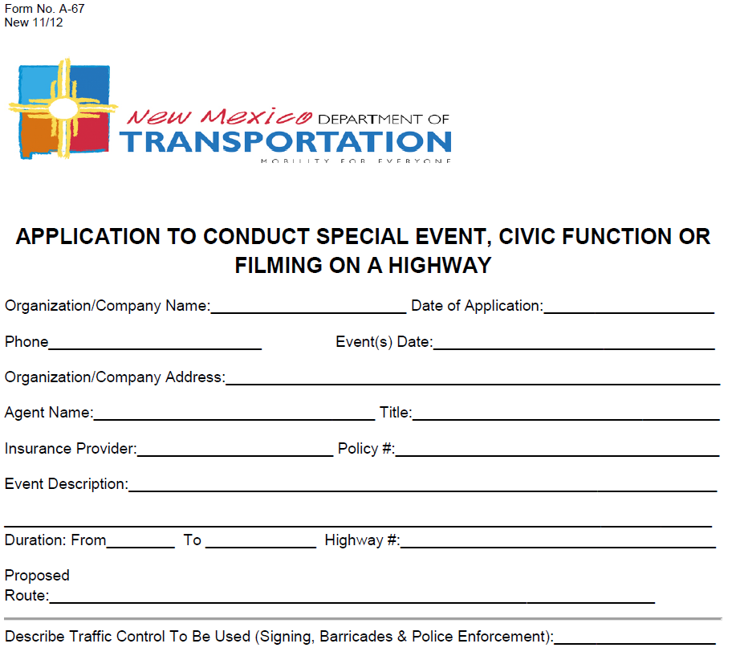
FORM NO. A-67

Slide 16
Landscaping Agreement
Allows private individuals, business, or local governments to place and maintain landscaping in NMDOT Right of Way.
Requirements:
  Completed and signed permit application
  Indemnification and Hold Harmless Agreement
  Must be notarized
  Plan sheets of proposed landscaping
  Must show dimensions from edge of roadway, curb line, etc.
  Must show all materials to be used

Slide 17
Landscaping Agreement
  No shrubbery or bushes that could interfere with sight lines shall be planted or allowed to grow higher than 36” above roadway .
  Trees may be planted but lowest portion of lowest limbs must be 6 feet above roadway.
  Nothing will be allowed to overhang the curb or encroach on the roadway shoulder.
  All costs and expenses for the construction and maintenance of the landscaping shall be borne by the applicant.

Slide 18
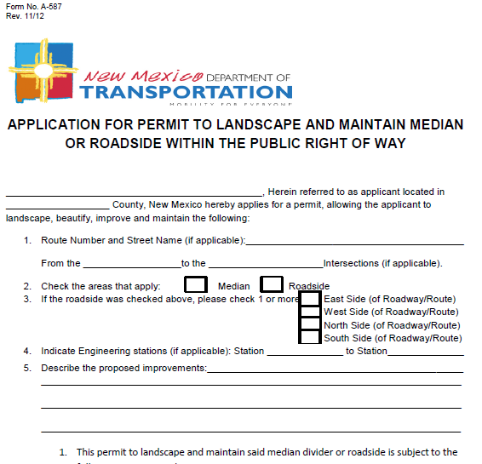
FORM NO. A-587

Slide 19
Other Permits
Interstate Access Permit Request
  Construction Project Access
    Must be associated with a current construction project
  Other - Pre-manufactured Home
  Must obtain general liability insurance covering the move in the amount of $1,050,000
  Must submit a traffic control plan. If utilizing law enforcement, must have written acknowledgement/ concurrence from the law enforcement agency

Slide 20
Other Permits
Fencing Removal Agreement
  Permits adjacent land owner to install their own fence and remove the NMDOT’s fence
    Owner is responsible for the construction and maintenance of the fence and all associated costs.
    Must indemnify and hold harmless the NMDOT
    Must supply drawing or plan of proposed fencing
    New fence shall be constructed parallel to the Department’s fence and approximately 3 feet onto the Owner’s property

Slide 21
Other Permits
Fencing Cooperative Agreement
  Provides fencing materials to property owners adjacent to replace/install new fencing along NMDOT Right of Way - helps to expedite fencing of the right of way in order to promote safety.
  Owner agrees to the following:
  Furnish all labor and equipment needed to construction the fence and gates
  Construct fence in conformance with NMDOT Department Standards, unless otherwise approved
  Construction must be completed within nine (9) months of receipt of the fencing material, unless and extension is granted.
  The NMDOT maintains ownership and will maintain the fence upon its completion.

Slide 22
NMDOT Traffic Section Contacts
Gabriel Lucero, P.E. Karl Gonzales
District 4 Traffic Engineer (505) 617-5265
(505) 490-7709
Permits & Checklists can also be found at:
http://dot.state.nm.us/content/nmdot/en/Infrastructure.html

